Slide 1
Drug Development of
Refractory Inflammatory Bowel Diseases
Hiroshi Shinjo
Himuka AM Pharma Corp, Miyazaki, Japan
Himuka AM will provide a solution for patients who are suffering from refractory Inflammatory Bowel Diseases. Our noble tissue remodeling agent induces mucosal healing and deep remission directly and safely.
www.himuka-am.com
himuka-am-info@himuka-am.co.jp

Slide 2
PROBLEMS
Inflammatory Bowel Diseases (IBD)
Figures source: World IBD Day https://worldibdday.org/about-us

Slide 3
PROBLEMS (cont'd)
Mucosal healing
A key therapeutic goal in the clinical management
The biological agents does not meet the medical needs.
 | Biologics
MOA | Regulation of inflammatory cytokine
Benefits & Risks
Anti-inflammation
Mucosal healing
Safety to immune system
Cost

Slide 4
CONCEPT
Wide and deep ulcers
Anti-inflammatory agent
Tissue remodeling agent
- Conventional therapy
5-ASA
Steroids
- Immunosuppressants
- Biologics
anti-TNF Abs.
anti-Interleukin Abs.
Cell adhesion mol. Abs.
- JAK inhibitors
Risk of infection
”Mucosal Healing”
Colonic lesions had healed with scarring.

Slide 5
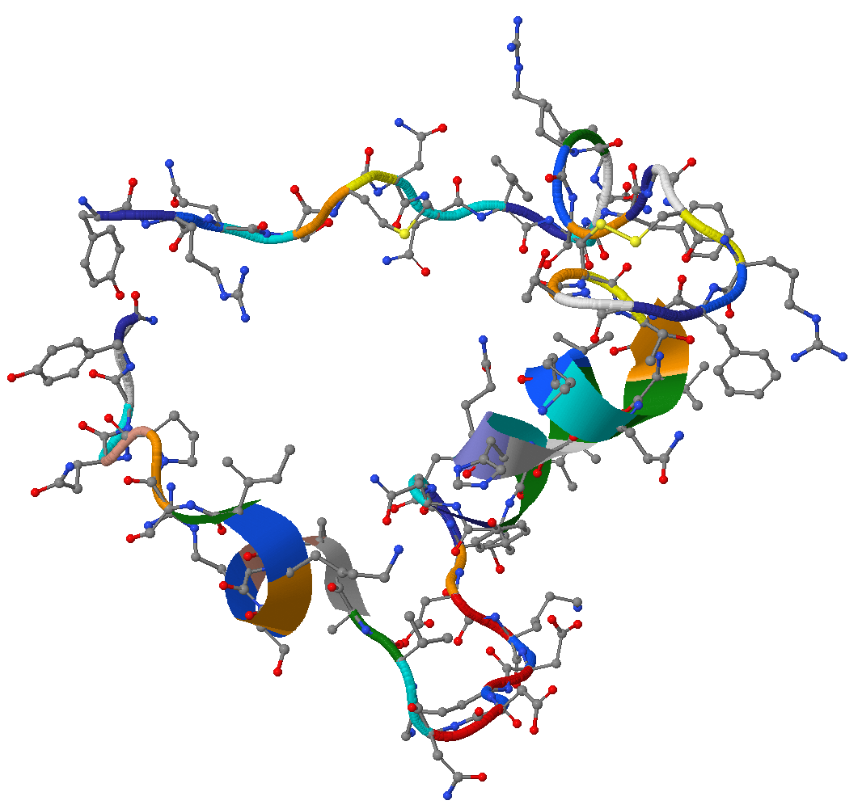
SOLUTIONS
NOVEL MECHANISM & SAFE THERAPY
Adrenomedullin (AM)
Mucosal healing
- Regeneration of mucosal
epithelial cells
- Junction molecule
expression
Anti-inflammatory
- Regulation of cytokine
Angiogenesis
- Increase in blood flow
Remodeling of damaged tissue
Mucosal healing & Deep remission

Slide 6
BENEFITS FOR PATIENTS
Mucosal healing & Deep remission
 | Adrenomedullin | Biologics
MOA | Regulation of intestinal epithelial barrier function | Regulation of inflammatory cytokine
Benefits & Risks
Anti-inflammation
Mucosal healing
Safety to immune system
Cost
Combination use

Slide 7
DEVELOPMENT
Long-acting AM for the global market,
Targeting IBD patients who need tissue remodeling
Long-acting AM has advantages ;
- Improvement of stability
- Wide margin of safety
- Worldwide intellectual properties protection
First in Human Study in Australia

Slide 8
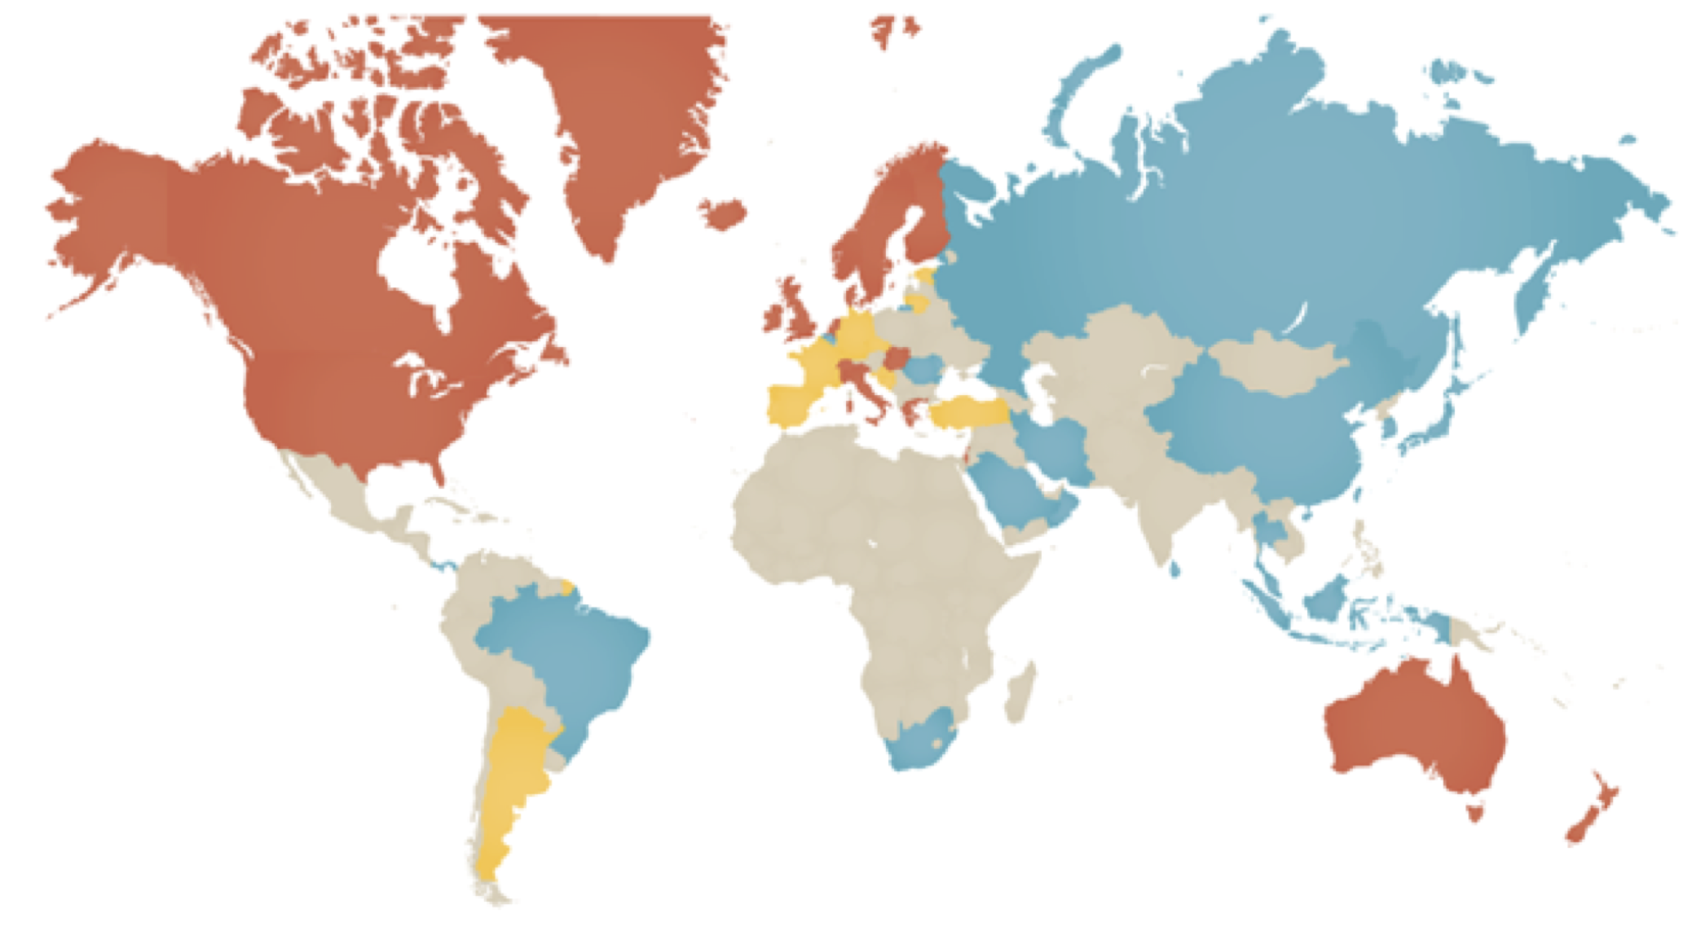
MARKET
IBD patients > 5 million
Estimated global sales
~ 2 B$
FUND-RAISING for the Development
4Q/2020 ~ 8 M$
3Q/2021 ~ 15 M$
Source of the figure: Gilaad G. Kaplan, Nature Reviews Gastroenterology & Hepatology 12, 720–727 (2015)

Slide 9
LIFE CYCLE MANAGEMENT OPPORTUNITIES
Stroke
COVID-19 associated pneumonia
Just has started with financial support by AMED

Slide 10
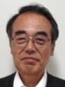
TEAM
Hiroshi Shinjo, CEO
Co-founder. Worked in the IP office at University of Miyazaki.
MBA, Patent Attorney
Motoo Yamasaki, CTO
Co-founder. Worked in the R&D division of Kyowa Hakko Kirin.
Ph.D.
Masanori Ishikawa
Worked in accounting firms and VCs.
CPA
Tsuyoshi Sakamoto
Outside board member. Partner of QB Capital LLC, Fukuoka.
MBA
Kazuo Kitamura
Scientific and medical advisor. Discoverer and investigator of Adrenomedullin. Professor at University of Miyazaki.
M.D., Ph.D.

Slide 11
www.himuka-am.com
himuka-am-info@himuka-am.co.jp
Himuka AM will provide a solution for patients who are suffering from refractory Inflammatory Bowel Diseases. Our noble tissue remodeling agent induces mucosal healing and deep remission directly and safely.

